Slide 1

Xtreme Dashboarding
Making sense of big data streaming and monitoring tools

Slide 2
The stakes
One of the most trending issue in big data processing...
Involves :
Continuous collection of data
Dynamic visualization with high-end web charting tools
Demanding storage facilities
Concerns all kind of industries where continuous data analysis can improve service quality or business strategy.
Applications are tremendous...

Slide 3


Real-Time Monitoring & Dash-boarding more than just insights
UI/UX
Our monitoring systems are designed with the user experience in mind, which means they have to be approachable for all stakeholders. For example, there are quick, simple views designed to give executives a snapshot of portal health. The executive view is green, red, yellow — that’s what they want to know. It is important that all information be put into context so the viewer could quickly compare current metrics with historical data and see how performance is shifting over time.
Mark G. Smith, Team Lead, Portal Monitoring - Optum - Health Solution and Care Delivery Organization
@GrafanaCONline 2022
Financial services
CIO of a bank or financial institution might traditionally have looked to data monitoring solutions. The problem with data monitoring is that you have to know what you want to know ahead of time (…). The answer lies in observability pipelines. These can drive operational efficiencies by getting the right data, to the right destinations – in the right formats – at the right time...
Nick Heudecker, Senior Director of Market Strategy for Cribl
Financial services turn to observability to aid diagnosis of breach investigations and threats, Financial Derivative, Feb 2022

Slide 4


Real-Time Monitoring & Dash-boarding beyond IT...
IT / Software Technology
Failure in complex systems is inevitable and cloud-native systems are getting more and more complex. If we want to operate these systems successfully and be prepared for the unknown, we should strive to build them as observable as possible
Claudio Scherrer - IT Dell Technologies Solution Architect
@DevOpsCon Berlin 2022
Sports / F1
For Formula 1, speed is about more than just how fast you go around the track. It’s also about having data at your fingertips in real time to make critical improvements before, during, and after the race (….) It’s so competitive that even one tenth-second advantage can change the outcome of the race.
Anshul Sharma - Product Manager at Microsoft - Formula 1 telemetry analysis
@GrafanaCONline 2022

Slide 5


Real-Time Monitoring & Dash-boarding rimes with RT Ingestion
Trading
With the first benchmark we did with Kafka, we saw that the capacity to ingest messages up to a rate of one million per second was easily achieved
Philippe Pujalte, Infrastructure & Operations Director at Euronext
EURONEXT.COM/EN
IoT / Ambient intelligence
As more projects come in and more topics are shared across teams and business units, we will be merging data from sales and marketing with data from production and manufacturing onto a single platform, and opening entirely new opportunities for innovative new products
Debusmann, Solution Architect chez Bosch Power Tools BDO Digital
BOSCH-PT.COM

Slide 6

Your challenges
Collection
Storage
Exploration
Analysis
Visualization
…for a very large amount of data
…with high performance and reliability

Slide 7

Your mission Big data monitoring system
As a Solution Architect working for a financial service company, you have to build a big data monitoring system that :
Continuously collects data from a cryptocurrency news feed
Continuously processes the collected data and provide analytics in real-time
Dynamically visualizes the provided analytics with the appropriate charting tools

Slide 8
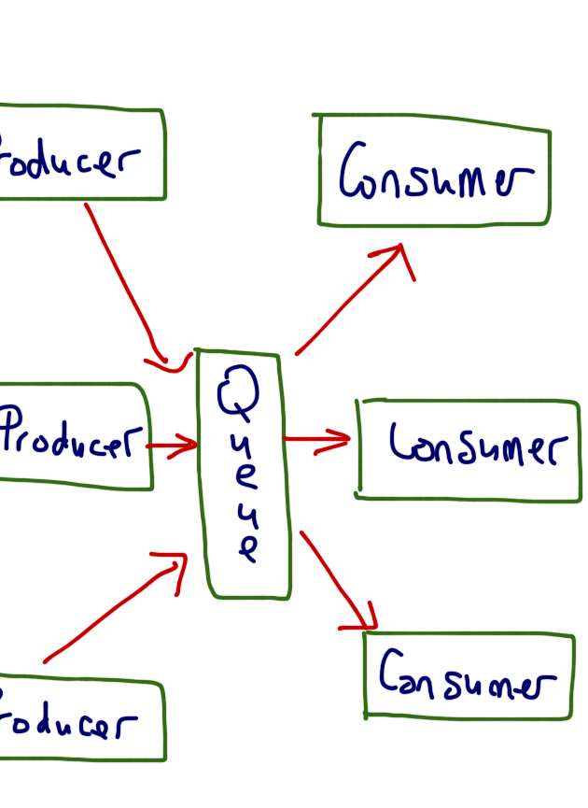
Your mission Big data monitoring system
The key paradigm : producer / consumer
Tools :
Kafka brokers
Spark clusters
Containerization tools
Web Charting tools
Data Scrapping tools
Etc.

